Slide 1
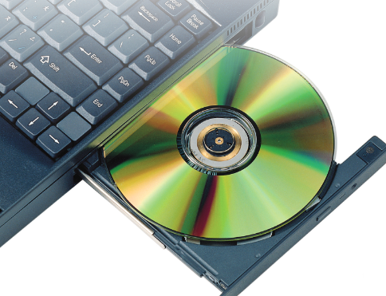
Principles of Information Technology
Chapter 19: Presentation Basics

Slide 2
Presentation Software
Presentation software allows you to organize and display information visually so it can be viewed by a group of people.
Information in a presentation is organized into separate pages. Each page is called a slide, and can contain one or more main points.
Work on a presentation may begin by selecting a template, or a preformatted version of a certain type of document.
A wizard is a series of dialog boxes that guide you through a step- by-step procedure to create a new presentation. The AutoContent wizard provides the steps for creating a presentation.

Slide 3
Presentation Formats
Most presentation programs let you choose a theme or template to quickly apply coordinated formatting to your slides.

Slide 4
Exploring Presentation Views
Types of presentation views include:
Text and graphics can be added, removed, or edited in Normal view.
Slide Sorter view displays thumbnails of all of the slides in a presentation.
In Notes Page view, part of the screen displays the slide and the rest of the screen shows a text box. You can type notes in the text box to use during a presentation or to print as handouts.

Slide 5
Exploring Presentation Views
More types of presentation views include:
The primary on-screen method of previewing and displaying slides during a presentation is called Slide Show view.
Reading view is similar to Slide Show view, except the slides are not displayed full-screen.
Many programs let you use Master views to make universal style changes to every slide, notes page, and/or handout pages.

Slide 6
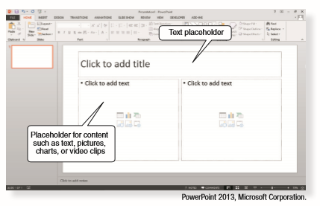
Designing Presentations
Following these five steps will help you plan, design, and save an effective presentation:
Decide how your slides will be formatted.
Choose the slide layout.
Work with placeholders, which is an area within a slide layout designed to hold data such as text or pictures.
Insert graphics and sound.
View and organize the presentation.

Slide 7
Adding Content to Presentations
You can insert many types of graphics in presentations, as well as tables and charts.
PowerPoint drawing tools also include ready-to-use shapes, called AutoShapes.
A multimedia presentation combines text and graphics with sound and animation, or moving images.

Slide 8
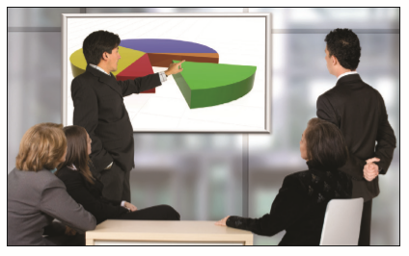
Creating Effective Presentations
Apply these seven steps to make your presentations effective:
One Idea Per Slide
Keep It Simple
Display Key Facts
Mix It Up
Use Color Cautiously
Watch the Fonts
Make It Readable

Slide 9
Chapter Review
The disadvantages to adding clip art to PowerPoint presentations are they might be overused or misused to the point of distraction.
It's important to limit each slide in a presentation to a main concept or idea because too much information is distracting and difﬁcult for most audiences.
It's important to preview your presentation from the back of the room because issues of size, clarity, and color can be corrected if the presentation is previewed in the actual setting.

